Slide 1
Telecom Churn Prediction Analysis
Analyzing and Predicting Customer Churn in the Telecom Industry
Anuj Garg

Slide 2
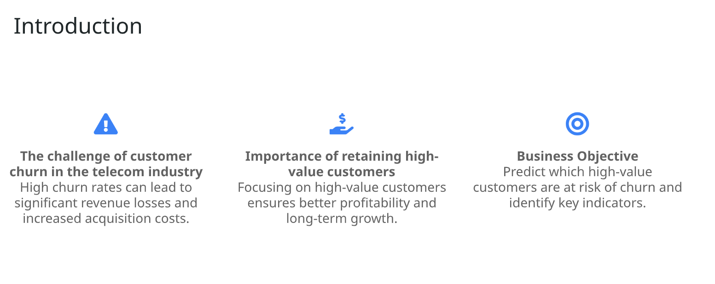

Slide 3
Understanding the Data
Data Overview:
Customer-level data across four months: June, July, August, and September.
Focus on the first three months for predicting churn in the fourth month.
Key Data Points:
Customer usage metrics (calls, SMS, data usage).
Recharge behavior and other relevant metrics.

Slide 4
Data Preprocessing
Data Cleaning:
Handling missing values.
Filtering out low-value customers.
Churn Definition:
Customers who made no calls and used no data in the ninth month were labeled as churners.
All ninth-month data was excluded from the predictive modeling to prevent data leakage.

Slide 5
Exploratory Data Analysis (EDA)
Customer Behavior Patterns:
Trends in usage during the ‘good’ and ‘action’ phases.
Visualizations (charts or graphs showing key metrics).
Insights:
Differences in usage patterns between churners and non-churners.

Slide 6
Feature Engineering
Feature Selection:
Metrics derived from customer behaviour (e.g., total recharge amount, total call duration).
Rationale for choosing these features.
Handling Categorical Variables:
Conversion of categorical variables into dummy/indicator variables.

Slide 7
Model Building
Model Selection:
Logistic Regression and Random Forest were chosen.
Brief explanation of why these models were selected.

Slide 8
Training and Testing
Data was split into training and test sets.
Standardization of features.

Slide 9
Model Evaluation
Model Performance:
Accuracy, ROC AUC Score for both models.
Confusion Matrix for Random Forest.
Classification report highlighting precision, recall, and F1-score.
Comparison:
Which model performed better and why?

Slide 10
Feature Importance
Top Predictors of Churn:
Visual representation of the most important features from the Random Forest model.
Interpretation of these features.
Insights:
How these features influence customer churn.

Slide 11
Business Recommendations
Strategies to Reduce Churn:
Targeted offers for high-value customers.
Proactive engagement with customers showing signs of churn.
Improving service quality in areas identified as weak spots.
Next Steps:
Continuous monitoring of churn patterns.
Implementing customer retention programs based on model predictions.

Slide 12
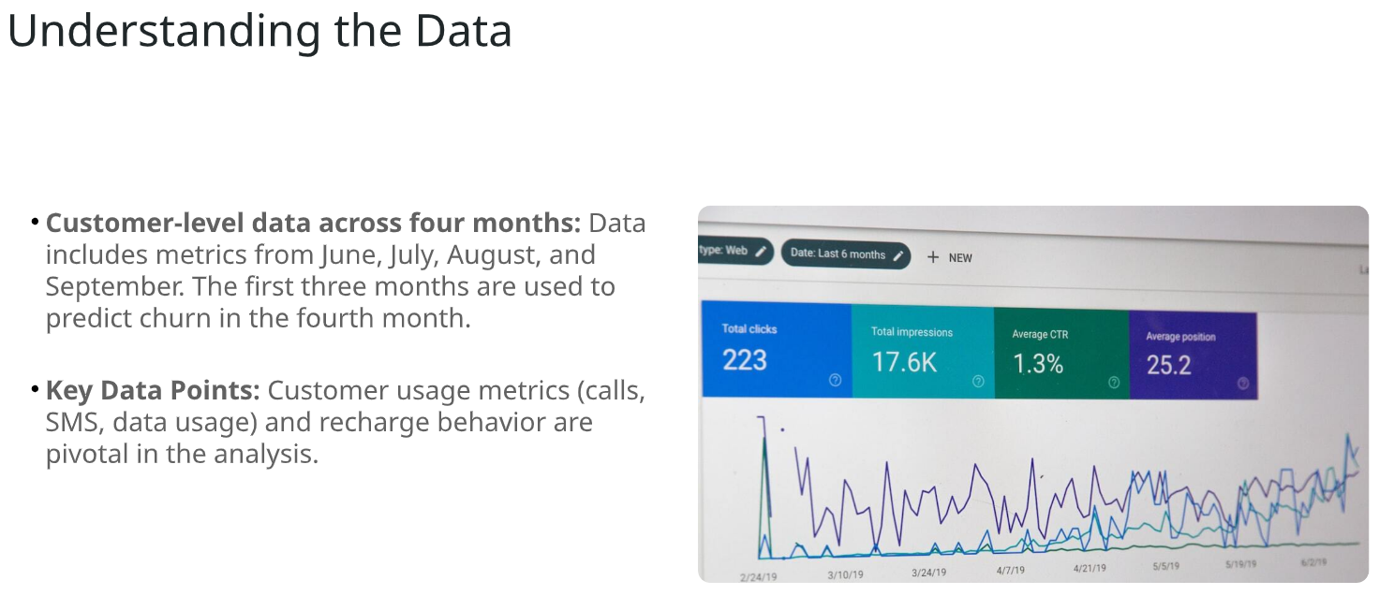
Conclusion

